Slide 1
CRM Software
Way Housing Pvt. Ltd

Slide 2
Modules Selection
Freelancer Join
Customer Management
Commission Calculation
Reporting
Project Management
Training Management
Target Achieve Management

Slide 3
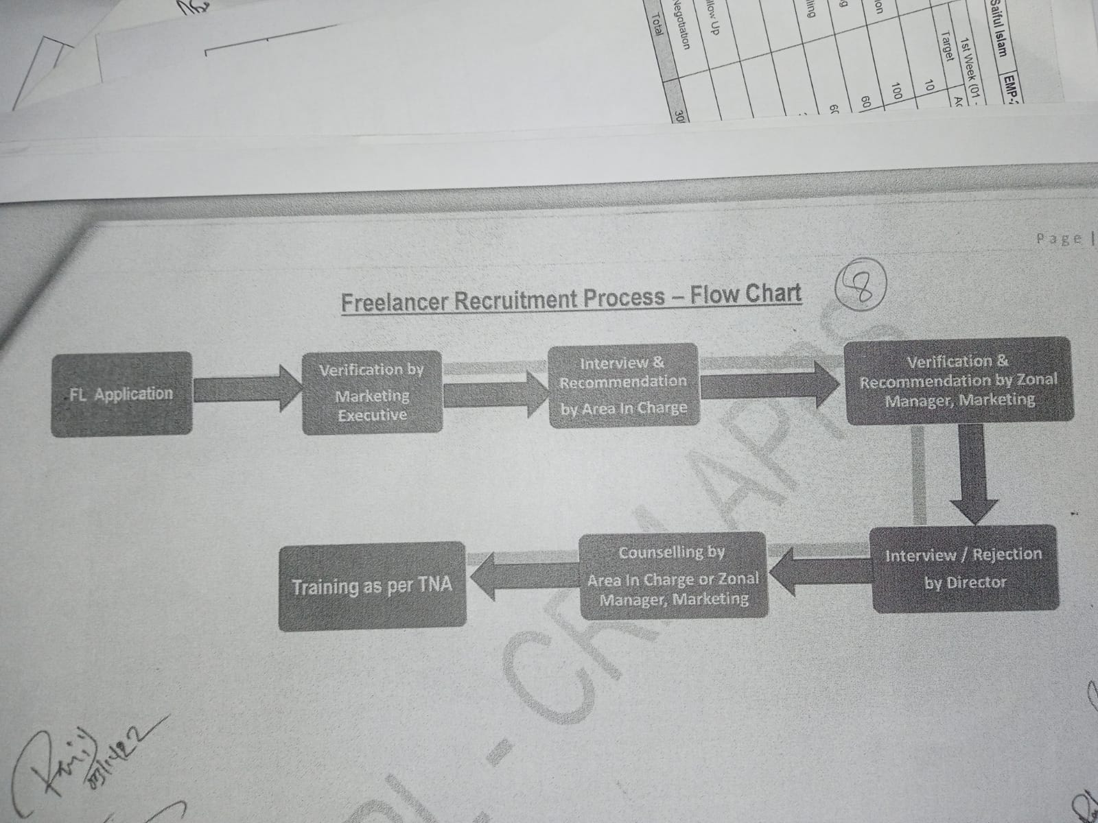
Freelancer Join

Slide 4
Customer Management
Marketing Executive
Customer Entry
Sales Executive
Presentation
Top Employee
Customer Entry
Prospecting
Cold Calling
Lead
Follow Up
Negotiation
Sales Closing
Prospecting
Cold Calling
Lead
Presentation
Follow Up
Negotiation
Sales Closing
All Report

Slide 5
Commission Calculation
Employee
Commission percent
Admin
Set Commission Percent
Commission History
Commission Withdraw history
Every Employer Commission History List
Every Employee Withdraw history
Commission Balance
Every Employee Commission Balance

Slide 6
Project Management
Project Add
Project Customer List
Project Selling History

Slide 7
Training Management
Make Training Schedule Calendar
Freelancer apply and approve for training
Training Attendance and Remark

Slide 8
Target and Achievement
Daily task Assign [Hour wise]
Monthly Target assign by reporting boss
Automatic generate daily task from monthly target.

Slide 9
Development Planning

Slide 10
Thanks

